Slide 1
TNGS Learning Solutions AWS Solutions Architect Online Course AWS Account SignUp

Slide 2
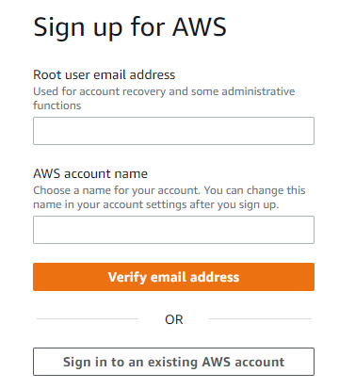
AWS signup step by step process
Click on the URL below to open AWS signup page
https://portal.aws.amazon.com/billing/signup#/start/email
Enter the following;
Root user email address
AWS account name
Click on Verify email Address
Check your email and
Provide Verification Code
Click on Verify

Slide 3
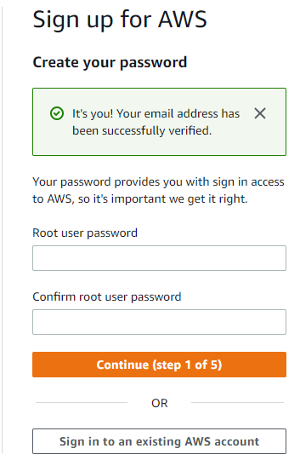
Enter;
Root user password
Confirm root user password
Click on Continue.

Slide 4
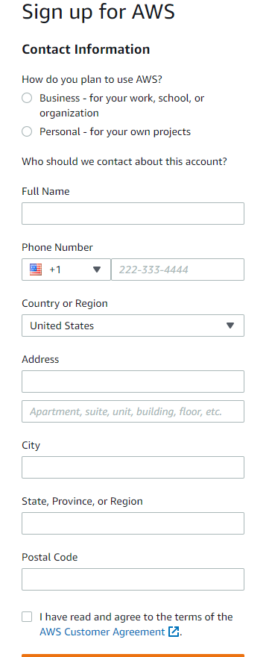
Select;
Personal –for your own project
Enter the following;
Full name
Phone number
Country or region
Address
City
State, Province, or Region
Postal Code
Select;
I have read and agree to the terms of the
Click on Continue.

Slide 5
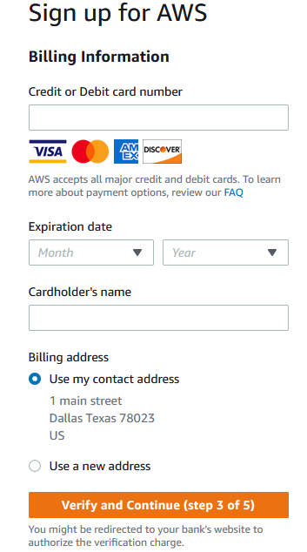
Then provide your credit/debit card details
Specify billing address

Slide 6
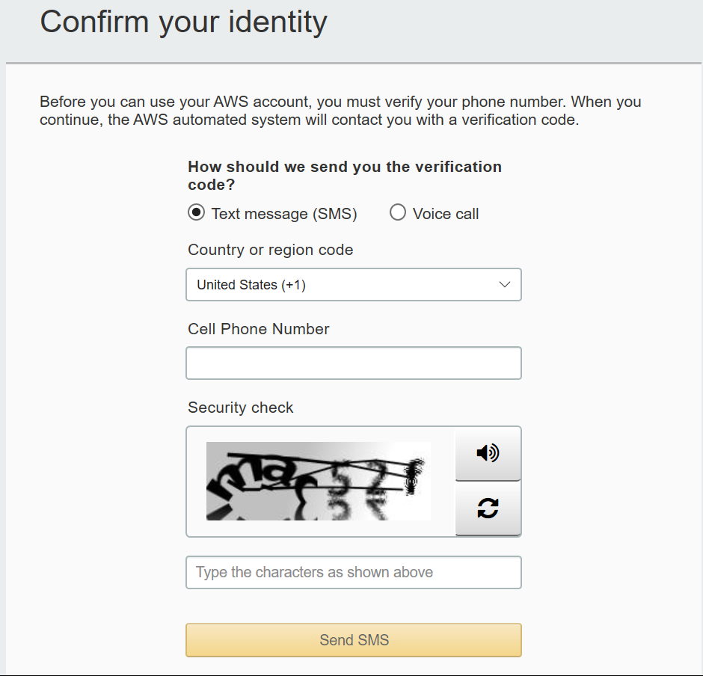
Next, provide you phone information for phone verification, note that you will get IVR call on the specified number make a note of that. Then click on call Me Now when you are ready.

Slide 7
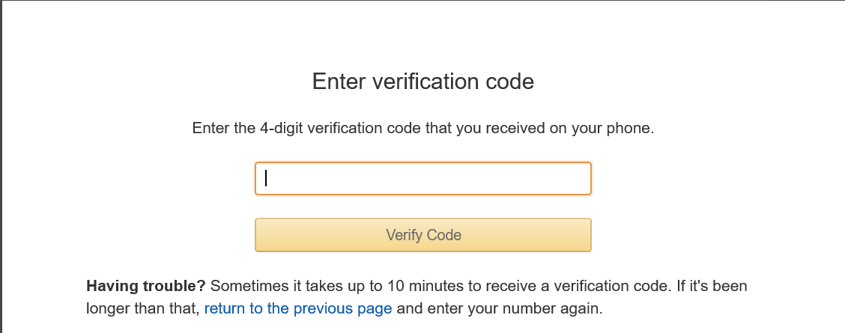
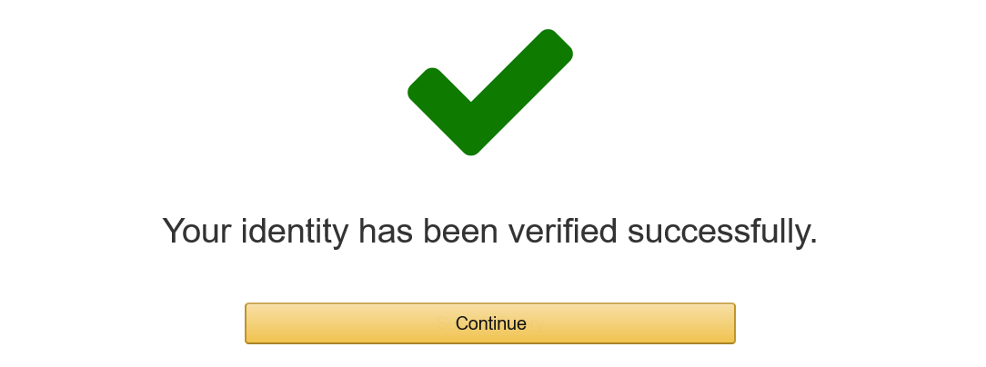
Once completed successfully, you will get a confirmation like this.

Slide 8
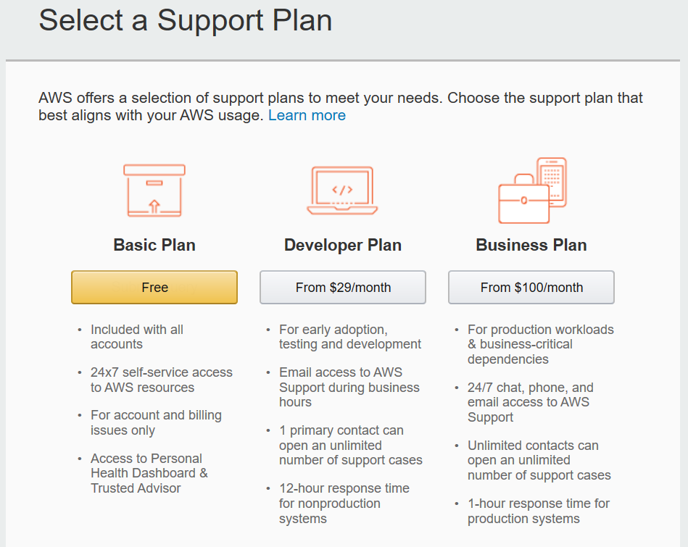
Next, select the support plan as Basic Plan which is free.
You can find the more information on the below link regarding the support plans and its features
https://aws.amazon.com/premiumsupport/plans/

Slide 9
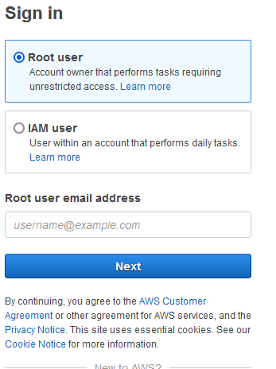
Provide your email id which you have used to sign up to AWS, then click on Next.
Next provide your password and click on sign in to sing into AWS console.

Slide 10
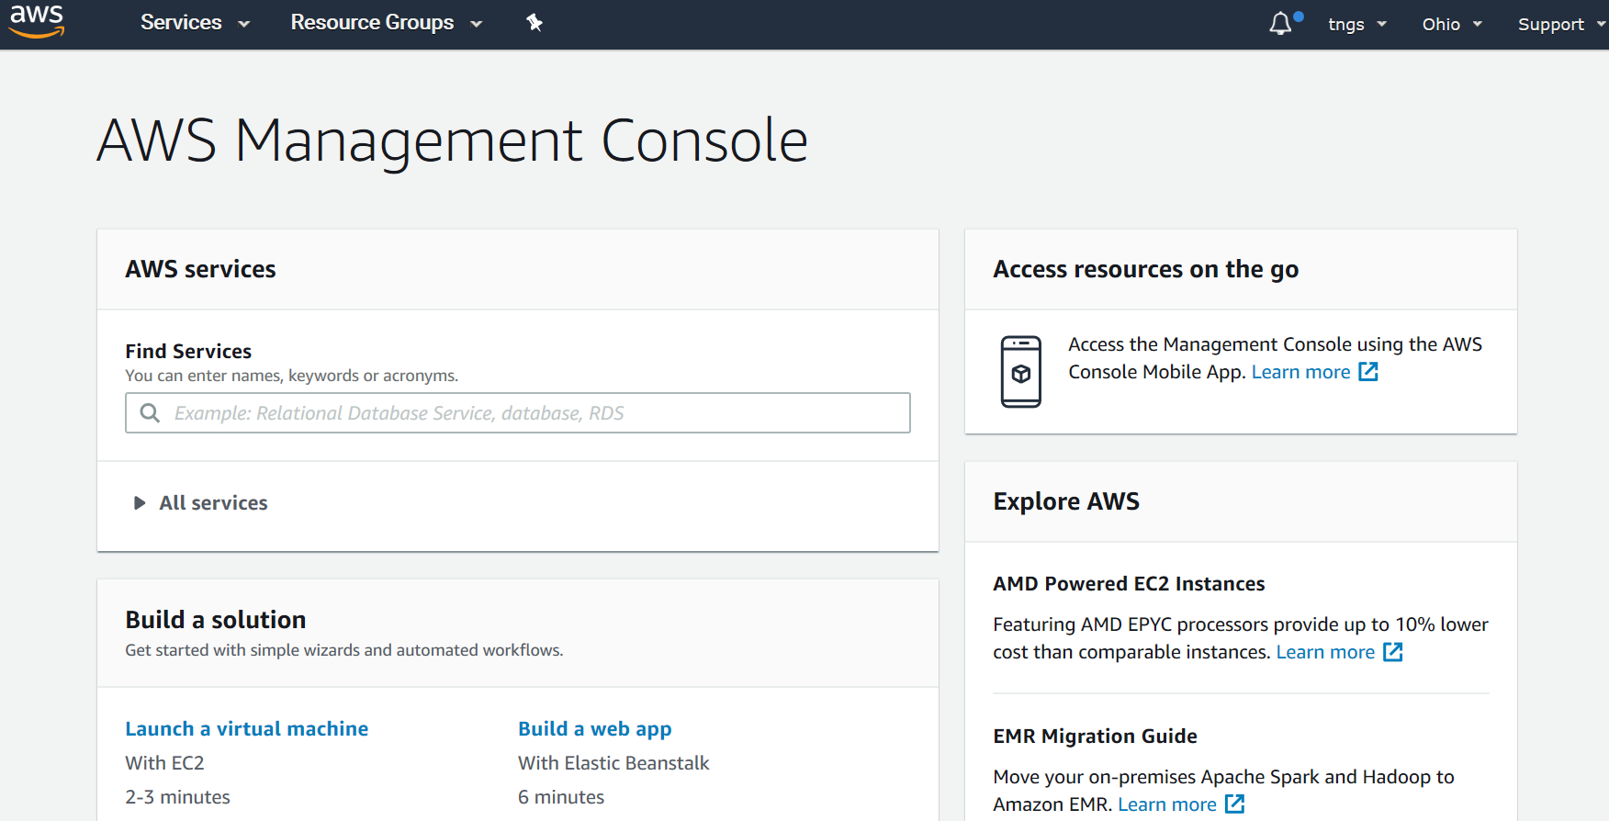
Once signed in you will get in to AWS console look like above.

